Slide 1

Chapter 11: Project Risk Management
Information Technology Project Management, Seventh Edition
ĐẶNG THỊ THU HÀ – SE
dtthuha79@gmail.com
https://lms.iuh.edu.vn
.

Slide 2
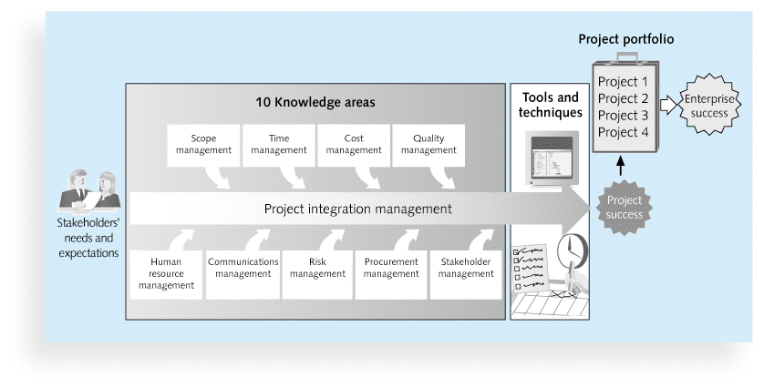

Slide 3
Learning Objectives
Explain the concept of risk as it relates to project management, and list the advantages of managing project risks according to best practices
Describe the process of identifying risks and create a risk register and risk report
Explain quantitative risk analysis and how to apply decision trees, simulation, and sensitivity analysis to quantify risks

Slide 4

The Importance of Project Risk Management
Project risk management is the art and science of identifying, analyzing, and responding to risk throughout the life of a project and in the best interests of meeting project objectives
Risk management is often overlooked in projects, but it can help improve project success by helping select good projects, determining project scope, and developing realistic estimates
Notes:
overlooked bỏ qua

Slide 5
The Process of Project Risk Management
11.1.Planning risk management: deciding how to approach and plan the risk management activities for the project
11.2.Identifying risks: determining which risks are likely to affect a project and documenting the characteristics of each
11.3.Performing qualitative risk analysis: prioritizing risks based on their probability and impact of occurrence

Slide 6
The Process of Project Risk Management
11.4.Performing quantitative risk analysis: numerically estimating the effects of risks on project objectives
11.5.Planning risk responses: taking steps to enhance opportunities and reduce threats to meeting project objectives
11.6.Monitoring risk: monitoring identified and residual risks, identifying new risks, carrying out risk response plans, and evaluating the effectiveness of risk strategies throughout the life of the project

Slide 7
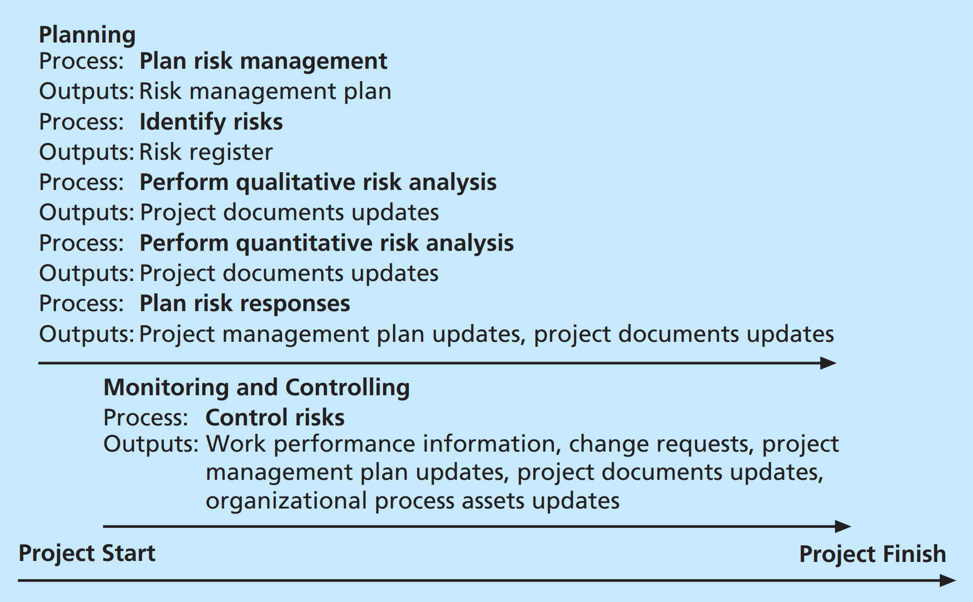

Slide 8
11.1.Planning Risk Management
Main output of this process is a risk management plan
Documents the procedures for managing risk throughout a project
The project team should review project documents as well as corporate risk management policies, risk categories, lessons-learned reports from past projects, and templates for creating a risk management plan
It is also important to review the risk tolerances of various stakeholders

Slide 9
Topic | Questions to Answer
Methodology | How will risk management be performed on this project? What tools and data sources are available and applicable?
Roles and responsibilities | Which people are responsible for implementing specific tasks and providing deliverables related to risk management?
Budget and schedule | What are the estimated costs and schedules for performing risk-related activities?
Risk categories | What are the main categories of risks that should be addressed on this project? Is there a risk breakdown structure for the project? (See the information on risk breakdown structures later in this chapter.)

Slide 10
Risk probability and impact | How will the probabilities and impacts of risk items be assessed? What scoring and interpretation methods will be used for the qualitative and quantitative analysis of risks? How will the probability and impact matrix be developed?
Revised stakeholders’ tolerances | Have stakeholders’ tolerances for risk changed? How will those changes affect the project?
Tracking | How will the team track risk management activities? How will lessons learned be documented and shared? How will risk management processes be audited?
Risk documentation | What reporting formats and processes will be used for risk management activities?

Slide 11
Common Sources of Risk on IT Projects
Other broad categories of risk help identify potential risks
Market risk
Financial risk
Technology risk
People risk
Structure/process risk
A risk breakdown structure is a hierarchy of potential risk categories for a project

Slide 12
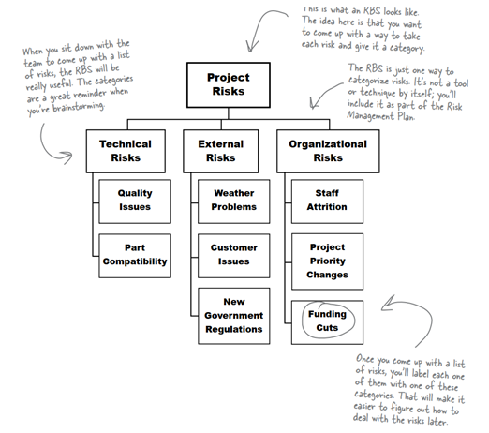

Slide 13
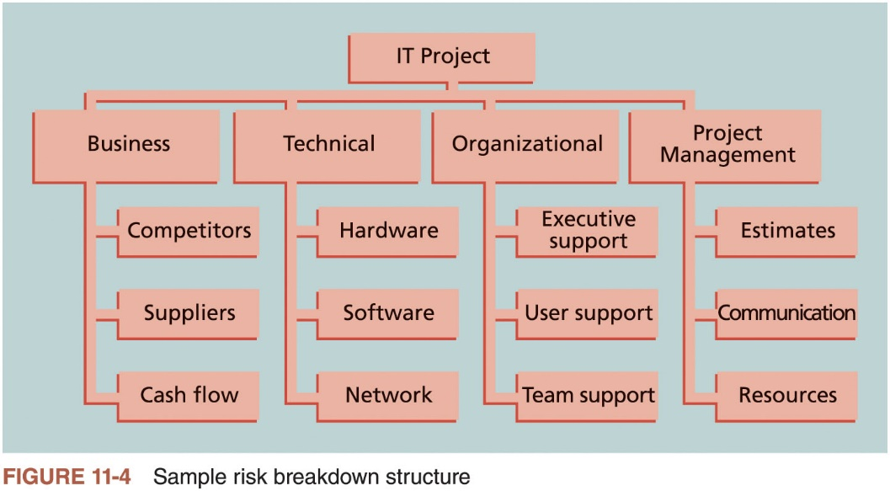
Common Sources of Risk on IT Projects

Slide 14
11.2.Identifying Risks
Understanding what potential events might hurt or enhance a particular project
Another consideration is the likelihood of advanced discovery
Suggestions for identifying risks: tools and techniques
Brainstorming
The Delphi Technique
Interviewing
SWOT analysis

Slide 15
Brainstorming
Group attempts to generate ideas or find a solution for a specific problem by amassing ideas spontaneously and without judgment
An experienced facilitator should run the brainstorming session
Be careful not to overuse or misuse brainstorming
Psychology literature shows that individuals produce a greater number of ideas working alone than they do through brainstorming in small, face-to-face groups
Group effects often inhibit idea generation

Slide 16
Delphi Technique
Used to derive a consensus among a panel of experts who make predictions about future developments
Provides independent and anonymous input regarding future events
Uses repeated rounds of questioning and written responses and avoids the biasing effects possible in oral methods

Slide 17
Interviewing
Fact-finding technique for collecting information in face-to-face, phone, e-mail, or virtual discussions
Interviewing people with similar project experience is an important tool for identifying potential risks
SWOT analysis
Strengths, weaknesses, opportunities, and threats
Helps identify the broad negative and positive risks that apply to a project

Slide 18

Triển khai:
S: Kinh nghiệm…., đi công tác xa,
W: Ko hiểu rõ sản phẩm (function, framework,…),
T: có user không hiểu, gặp trở ngại trên đường di chuyển, …

Slide 19
Triển khai”
Tree
TH1: (ko thành công)-0.1 (10%)
Value= 0.1*900$=90$
TH2: K thanh công – 0.9
value= 0.9*200=18$

Slide 20
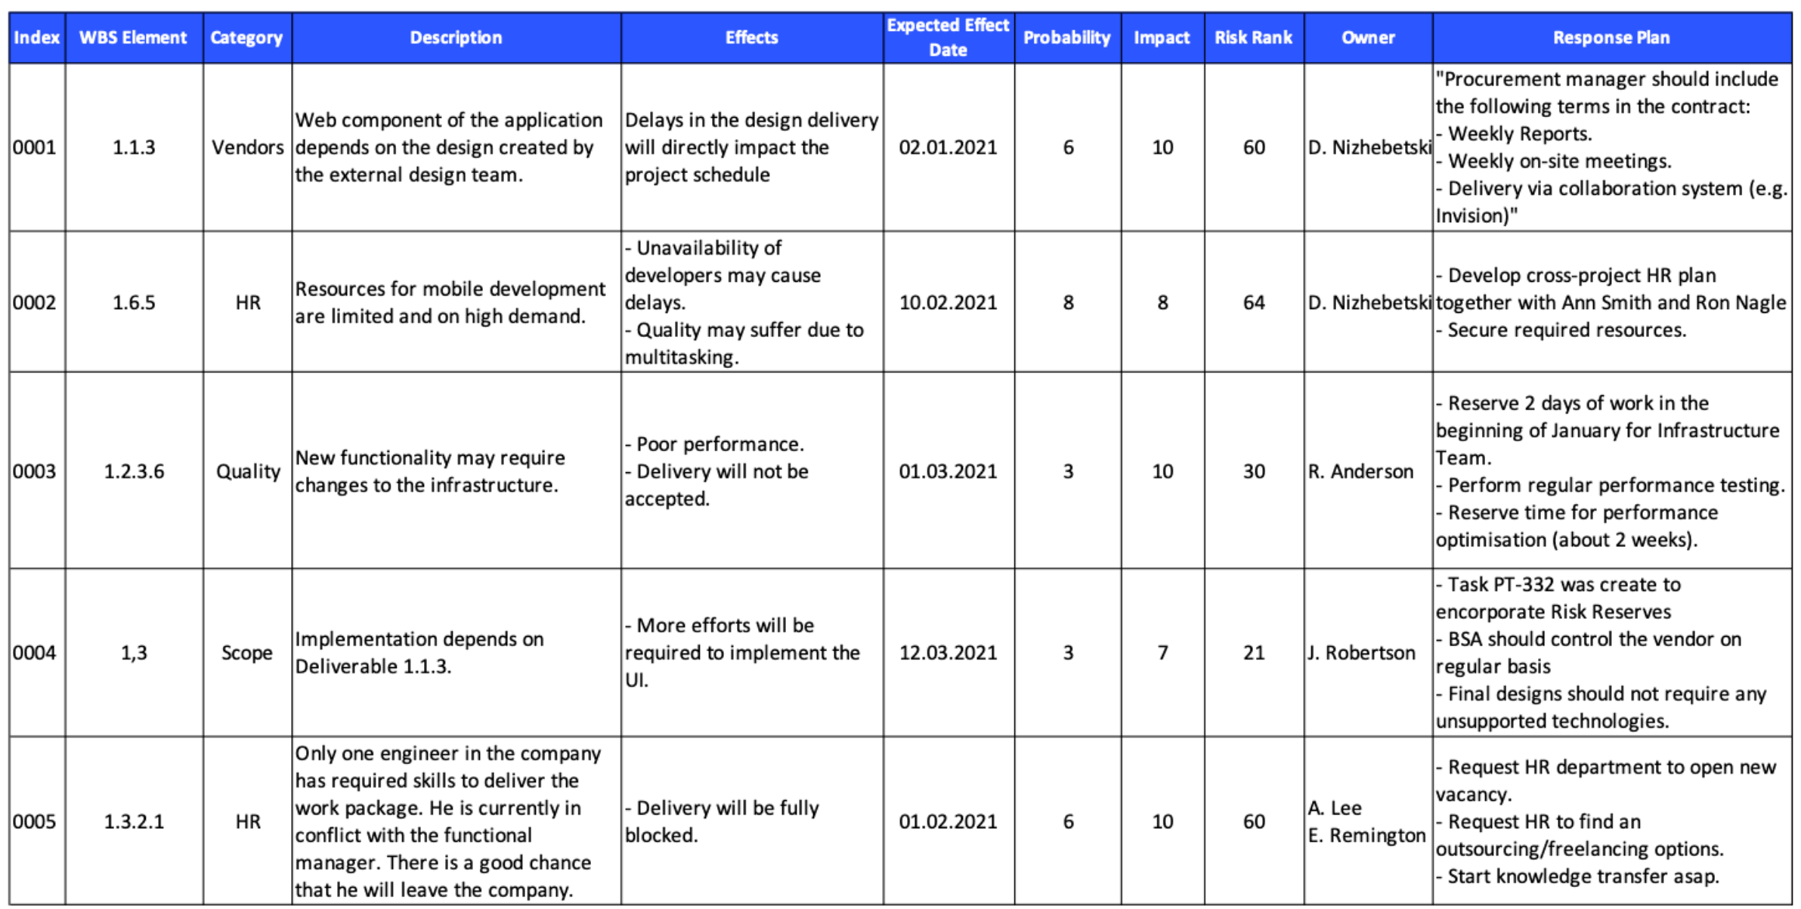
The Risk Register

Slide 21
11.3.Performing Qualitative Risk Analysis
Assess the likelihood and impact of identified risks to determine their magnitude and priority
Risk quantification tools and techniques
Probability/impact matrixes
Expert judgment
Notes:
Tính chất

Slide 22
Using Probability/Impact Matrixes to Calculate Risk Factors
Lists relative probability of a risk occurring on one side of a matrix or axis on a chart and the relative impact of the risk occurring
List the risks and then label each one as high, medium, or low in terms of its probability of occurrence and its impact if it did occur
Calculates risk factors
Numbers that represent the overall risk of specific events based on their probability of occurring and the consequences to the project if they do occur

Slide 23
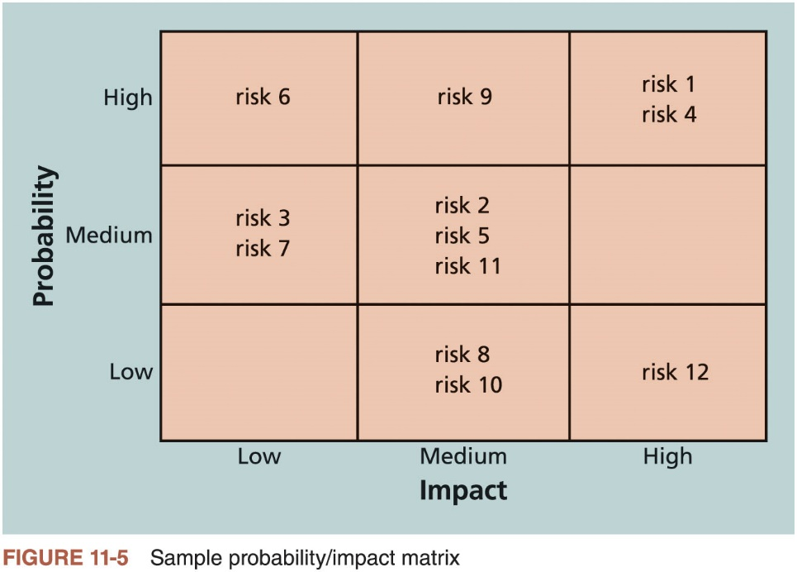
Using Probability/Impact Matrixes to Calculate Risk Factors

Slide 24
11.4.Performing Quantitative Risk Analysis
Often follows qualitative risk analysis, but both can be done together
Large, complex projects involving leading edge technologies often require extensive quantitative risk analysis
Main techniques
Decision tree analysis
Simulation
Sensitivity analysis
Notes:
Mức độ: định tính
Mô phỏng theo mẫu
Cảm tính

Slide 25
Decision Trees and Expected Monetary Value (EMV)
A decision tree is a diagramming analysis technique used to help select the best course of action in situations in which future outcomes are uncertain
Estimated monetary value (EMV) is the product of a risk event probability and the risk event’s monetary value
You can draw a decision tree to help find the EMV

Slide 26
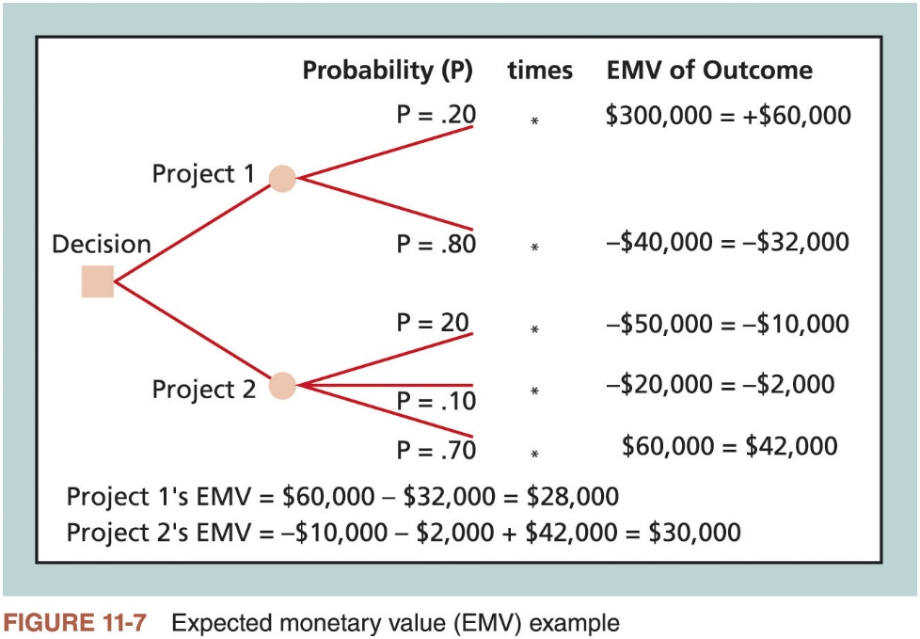
Decision Trees and Expected Monetary Value (EMV)

Slide 27
Simulation
Uses a representation or model of a system to analyze the expected behavior or performance of the system
Monte Carlo analysis simulates a model’s outcome many times to provide a statistical distribution of the calculated results
Predict the probability of finishing by a certain date or the probability that the cost will be equal to or less than a certain value
You can use several different types of distribution functions when performing a Monte Carlo analysis

Slide 28
Simulation
Steps of a Monte Carlo analysis
Collect the most likely, optimistic, and pessimistic estimates for the variables in the model
Determine the probability distribution of each variable
Select a random value based on the probability distribution for each variable
Run a deterministic analysis or one pass through the model
Repeat steps three and four many times to obtain the probability distribution of the model’s results

Slide 29
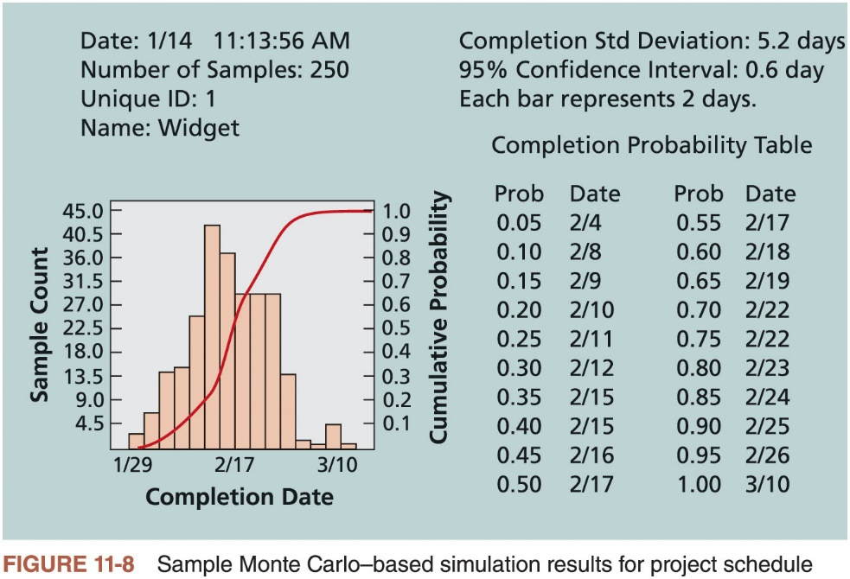
Simulation

Slide 30
Sensitivity Analysis
Used to show the effects of changing one or more variables on an outcome
For example, many people use it to determine what the monthly payments for a loan will be given different interest rates or periods of the loan
Spreadsheet software, such as Microsoft Excel, is a common tool for performing sensitivity analysis

Slide 31


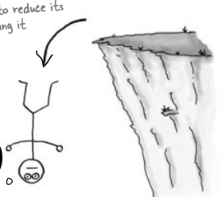

11.5.Planning Risk Responses
Risk avoidance
Risk transference
Risk acceptance
Risk mitigation

Slide 32
11.6.Monitoring Risks
Involves ensuring the appropriate risk responses are performed, tracking identified risks, identifying and analyzing new risk, and evaluating effectiveness of risk management throughout the entire project
Project risk management does not stop with the initial risk analysis

Slide 33
Monitoring Risks
Carrying out individual risk management plans involves monitoring risks based on defined milestones and making decisions regarding risks and their response strategies
Project teams sometimes use workarounds—unplanned responses to risk events—when they do not have contingency plans in place

Slide 34
Chapter Summary
Risk is an uncertainty that can have a negative or positive effect on meeting project objectives
Risk management is an investment
Implementing risk responses involves putting the appropriate risk response plans into action
Monitoring risks involves monitoring implementation of risk response plans, tracking identified risks, identifying and analyzing new risks, and evaluating effectiveness of risk management throughout the entire project

